Slide 1
What is the UK’S WHOLE FORCE APPROACH?
Brigadier Matt Bazeley
Commandant
Royal School of Military Engineering (UK)

Slide 2
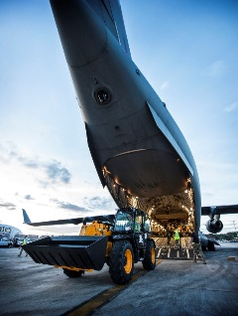
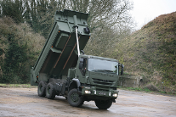

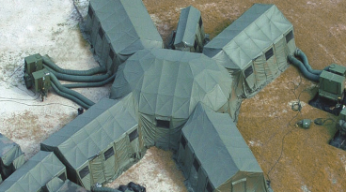
What is the UK’S WHOLE FORCE APPROACH?
SCOPE
Context
Principles
Implementation
Risks
Strengths
Summary

Slide 3


What is the UK’S WHOLE FORCE APPROACH?
Definition
“The Whole Force Approach is an effective, agile and resilient capability delivered by an integrated, pre-planned and affordable mix of regular and reserve military, civilian and industry resources as a first choice to meet Defence Outputs”
Executive Committee of the Army Board
“Whole Force Approach comprises all the organisations, people and competencies that combine to enable generation and effective national-defence capabilities.”
Royal United Services Institute

Slide 4
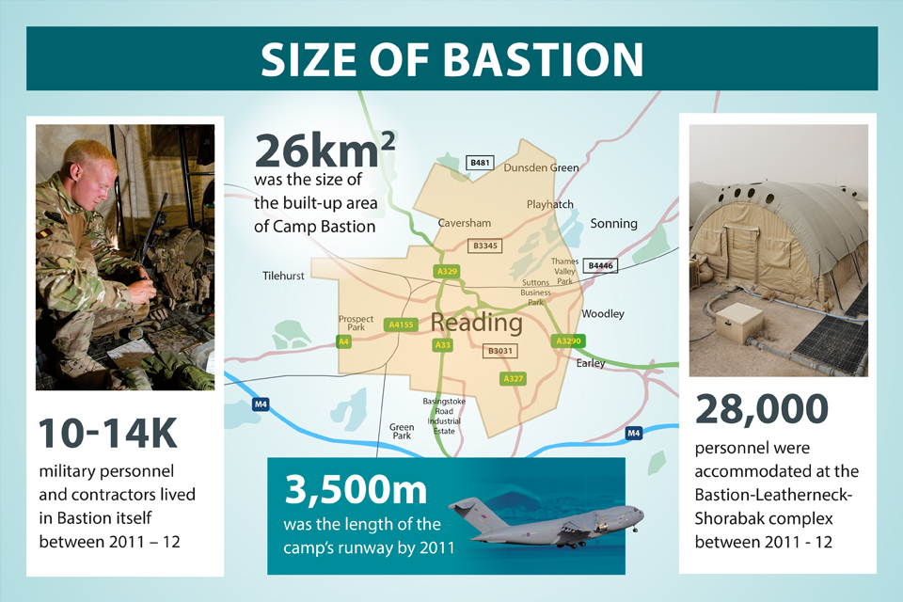
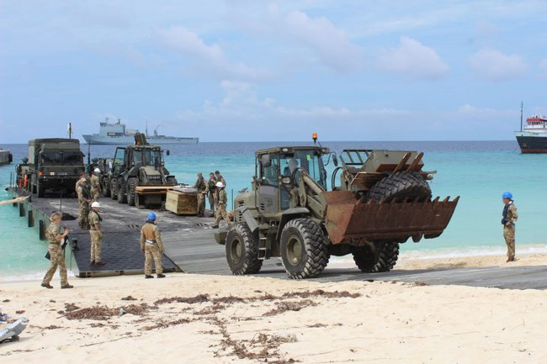


What is the UK’S WHOLE FORCE APPROACH?
Context
Why the need for change?
Manpower prioritisation
Increase in commoditised services
Cold War force structure
Not a new approach for everyone
And……

Slide 5

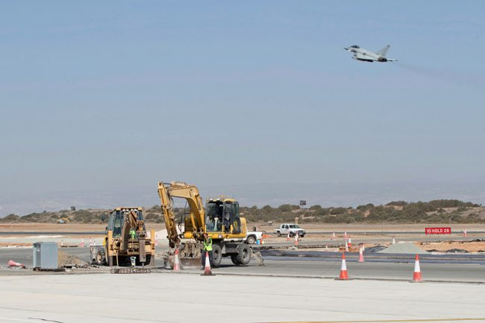
What is the UK’S WHOLE FORCE APPROACH?
Economics
£200 billion per year spent by the British Government outsourcing services to industry
20-30% Savings of outsourcing
Non Core Business Activities should be outsourced

Slide 6


What is the UK’S WHOLE FORCE APPROACH?
Historical RISKS
Complex Supply Chains
Resilience to shock
Sovereignty of the Supply Chain
Agility

Slide 7


What is the UK’S WHOLE FORCE APPROACH?
Whole Force Approach Principles
Civilian where possible Military where necessary
Planned
Assured
Resilient
Sustainable
Capability Led
Affordable

Slide 8
What is the UK’S WHOLE FORCE APPROACH?
OpERATIONAL Levels of Employment
War
Fighting
RISK
Civilian presence
Military Presence
Peace
Time
TIME

Slide 9
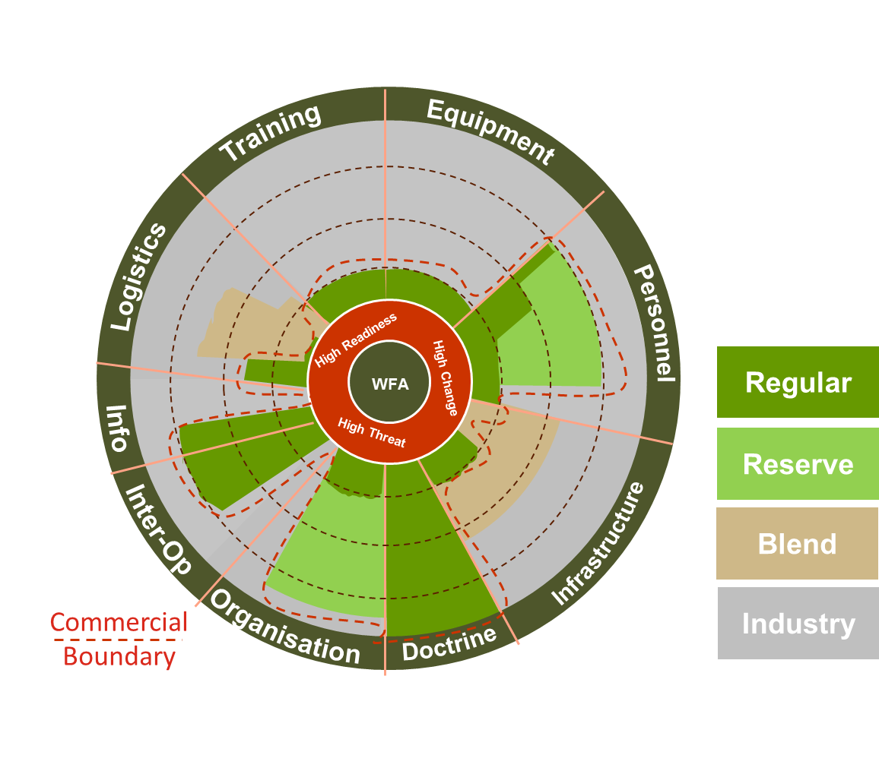
What is the UK’S WHOLE FORCE APPROACH?
FORCE MIX
Industry appetite
Training
Equipment
Personnel
Infrastructure
Doctrine
Organisation
Information
Logistics
Interoperability

Slide 10

What is the UK’S WHOLE FORCE APPROACH?
official
FORCE MIX
RSME PPP
Management & Administration
Management and Admin
Information Technology
Training
Equipment Support
Security
Transport
Stores and Engineer Resources
Catering Retail Leisure
official

Slide 11


official
What is the UK’S WHOLE FORCE APPROACH?
FORCE MIX
Ppp bENEFITS
Personnel reinvestment
  309 military, 419 civil service
Land disposal – 480 hectares
£320m of purpose built training facilities
Transformed courses
  Saving 37000 man training days*
Additional financial benefits:
  Insurance savings
  Early adoption of energy saving technology
  * As at 31 Oct 18
official

Slide 12


What is the UK’S WHOLE FORCE APPROACH?
Execution
2 trial Areas
  Material Distribution Land 2025
  Deployable Infrastructure 2028
Gradually
Evidence based approach
Adjust where necessary
Must be able to fail

Slide 13



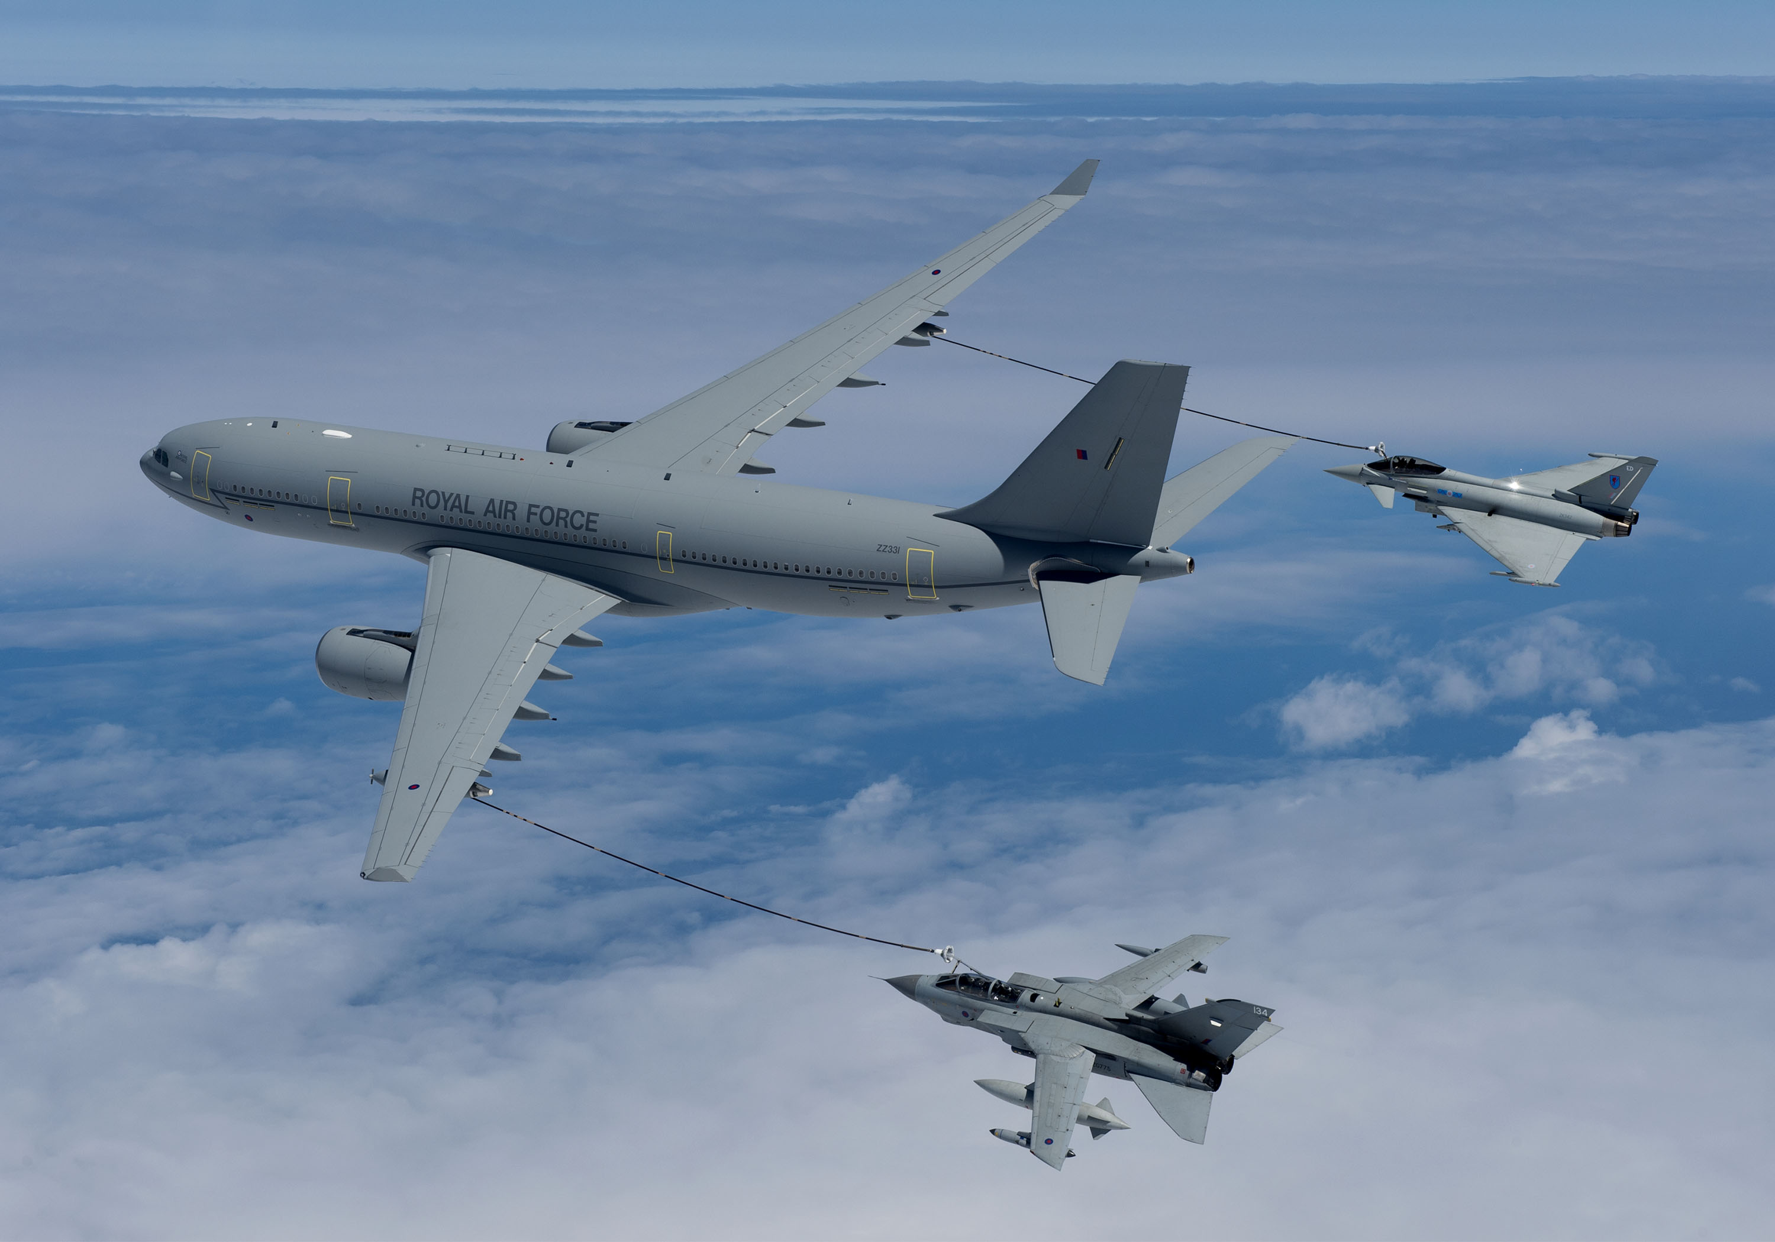
What is the UK’S WHOLE FORCE APPROACH?
EQUIPMENT USED BY INDUSTRY

Slide 14
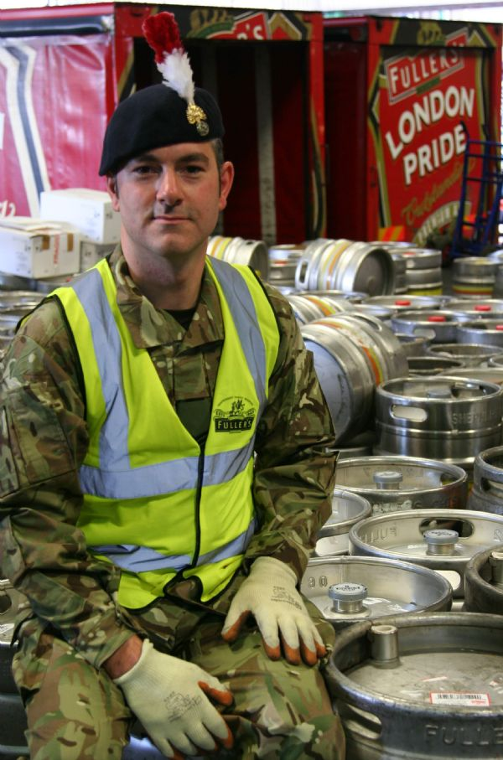

What is the UK’S WHOLE FORCE APPROACH?
ADVANTAGES
Utilising Industry Best Practice
Incorporating Innovation
Optimising Knowledge Skills and Experience
Lateral Entry
Improved Efficiency
Income Generation

Slide 15
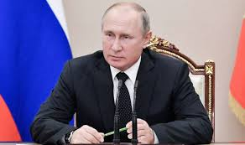

What is the UK’S WHOLE FORCE APPROACH?
RISKS
Presentational Risk
Operational Risk
Growing the skills and knowledge
required for Whole Force Approach

Slide 16



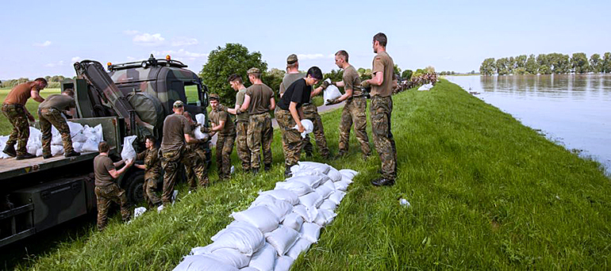
What is the UK’S WHOLE FORCE APPROACH?
What is YOUR PURPOSE?
Homeland Defence?
Deployable Operations?
Counter Insurgency?
Conventional War?
United Nations Support?
Support to other Government Agencies?

Slide 17
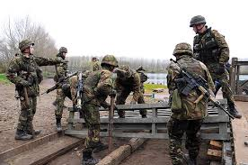
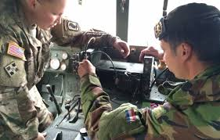
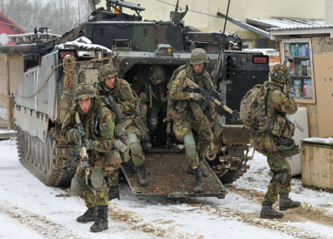
What is the UK’S WHOLE FORCE APPROACH?
SUMMARY
Contracts must remain relevant
Whole Force Approach is scalable
Industry is agile but has to make a profit
Collaborative relationships between Industry and the Military are Vital.

Slide 18
What is the UK’S WHOLE FORCE APPROACH?
Questions?

Slide 19
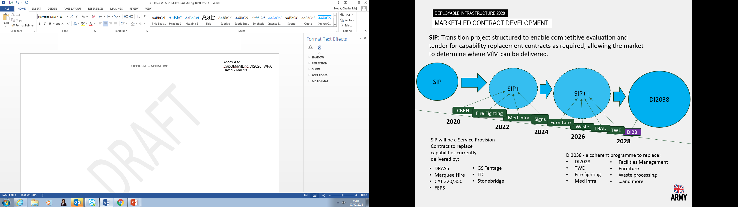
What is the UK’S WHOLE FORCE APPROACH?
Deployable INFRASTRUCTURE PATHWAY

Slide 20
What is the UK’S WHOLE FORCE APPROACH?
Deployable INFRASTRUCTURE PATHWAY
 |  | UK Defence | International Partners | OGDs | Industry
DI2028 Capability | Plant & Construction
 | Material Handling
 | Water supply
 | Shelters
 | Power
 | Fuel
Capability designed for UK Defence
Cost offset with employment/use by others partners

